Slide 1
The Value of Search & SEO
Notes:
Add a table of contents - agenda

Slide 2
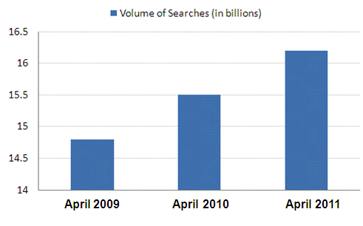
Why Search?
Searchers are actively engaged, intent driven users
64% of web users employ search as the primary method of finding things online
Notes:
Add a table of contents - agenda

Slide 3
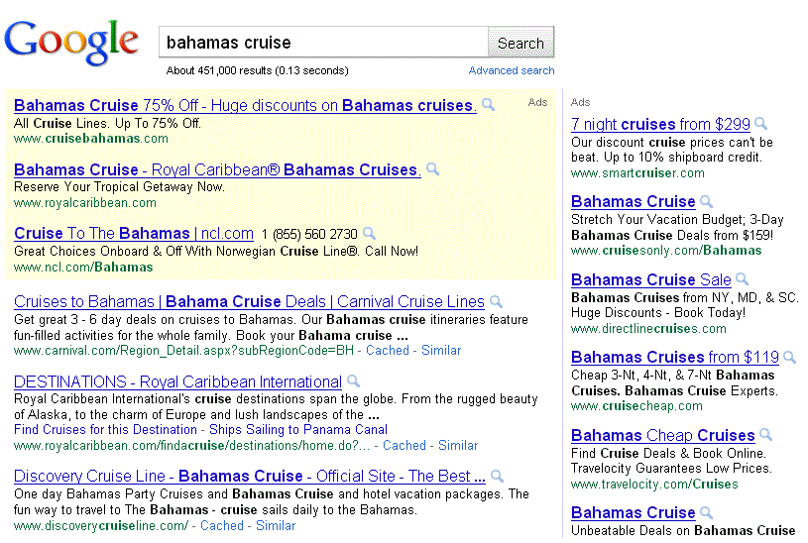
With Search Your Market Comes to You

Slide 4
Paid Search (PPC)

Slide 5
PPC (pay-per-click) Cost
Notes:
Add a table of contents - agenda

Slide 6
Organic (Natural) Search
Notes:
Add a table of contents - agenda

Slide 7
Organic (Natural) Search
85% of searchers click on organic results
Searchers trust organic listings more than paid and that organic results are perceived as most relevant
Organic search is one of the most cost-effective channel of qualified customer acquisition
Organic search provides value over time whereas paid search traffic disappears as soon as you stop your spend

Slide 8
But….
Search Engines are Imperfect
Search engines are still rudimentary technology
No single search engine can (yet) parse every type of content and every kind of content delivery platform
There are many gaps between what a browser can display and what a search engine can “see”
Notes:
SEO is used to bridge the gap between search engines and browsers

Slide 9
SEO (Search Engine Optimization)
Identify and resolve technical barriers to getting your site crawled and indexed
Understand how your market is looking for your content
Send the right signals to be visible for relevant search queries

Slide 10
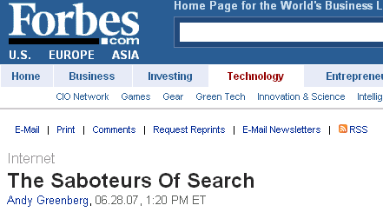
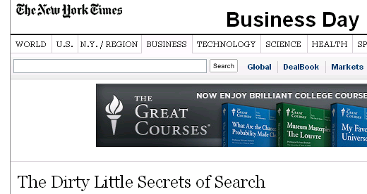
SEOs Eat Their Young!
(ok I made that one up, but….)
Notes:
Add a table of contents - agenda

Slide 11
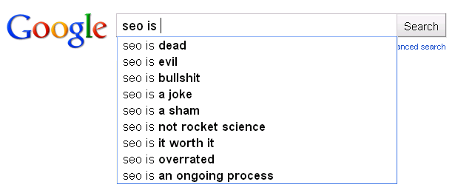
SEO does have a PR problem

Slide 12
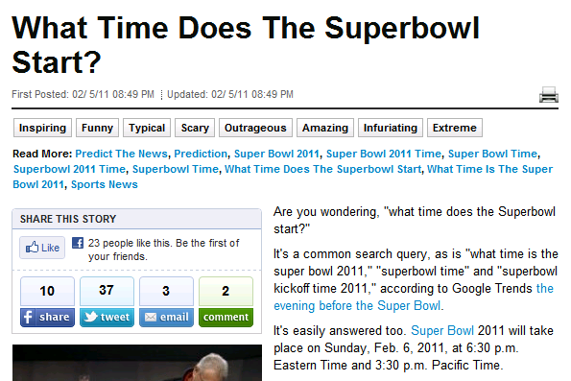
…and is it any wonder?

Slide 13
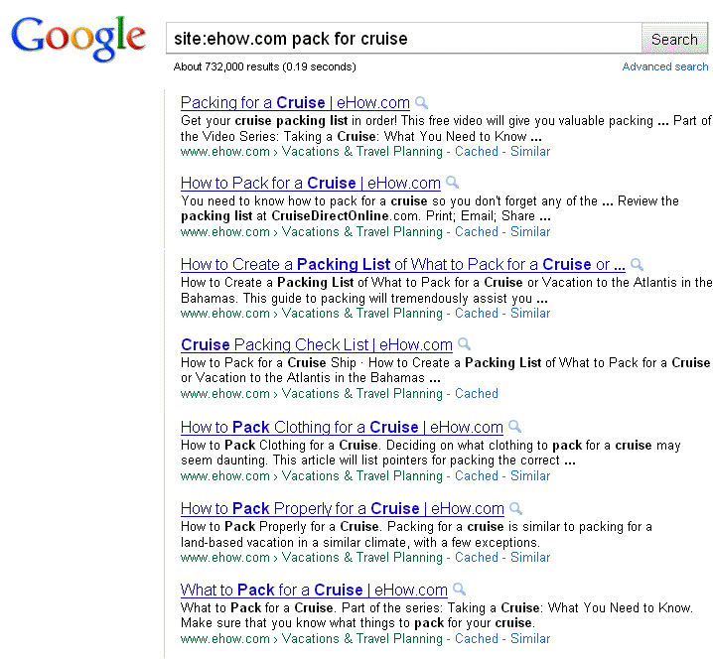
Really eHow?
Notes:
Add a table of contents - agenda

Slide 14
The Real Value of Search
Expose your brand to new customers
Generate revenue (sales, leads, subscriptions, ad impressions)
Support other initiatives (TV ads, trade shows, conferences)
Reinforce marketing messages
Drive people to a brick & mortar (map, hours, coupons, store locator)
Reducing staff resources (support library, FAQs)
Discover how your customers literally think about your brand/products
Measure awareness of your brand or specific messaging
Inform content/product development areas

Slide 15
SEO Dos & Don’ts

Slide 16
Sudden Surge in the Volume of Links Pointing to JCPenney.com
DON’T Waste Time Trying to Game the Algorithm
Notes:
Add a table of contents - agenda

Slide 17
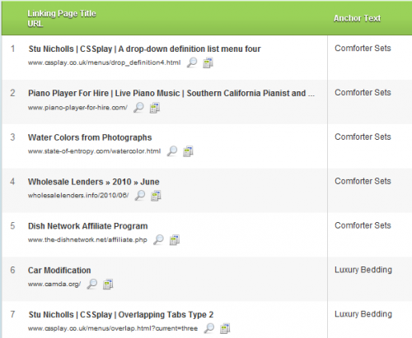
Sites that Suddenly Added Links to JCPenney.com
Notes:
Add a table of contents - agenda

Slide 18
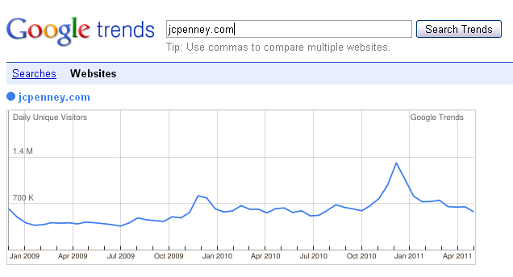
Not an Effective Long Term Strategy

Slide 19
DO Understand the Value of Different
Types of Search Queries
Information Queries
Transaction Queries
Navigation Queries

Slide 20
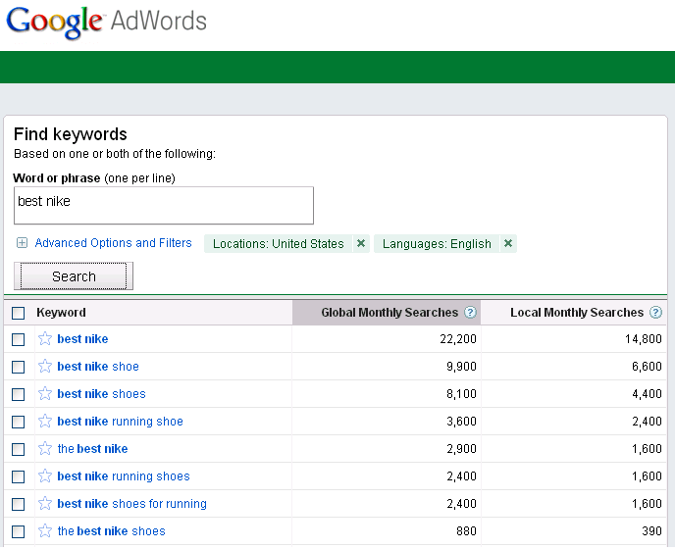
Information Queries - Search is Used to Research Purchases
58% of Americans conduct such research online “at least occasionally.”
78% of adult Internet users in the U.S. do product or service research online
Notes:
Add a table of contents - agenda

Slide 21
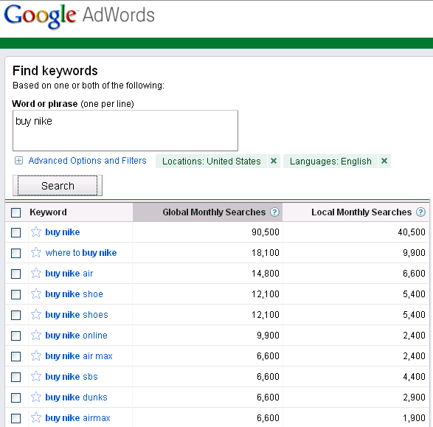
Transaction Queries – Search is Used to Buy
Notes:
Add a table of contents - agenda

Slide 22
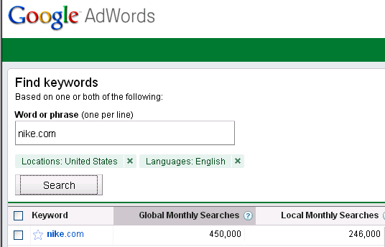
Navigation Queries – Search is Used to Navigate to a Known Brand or Website
Notes:
Add a table of contents - agenda

Slide 23
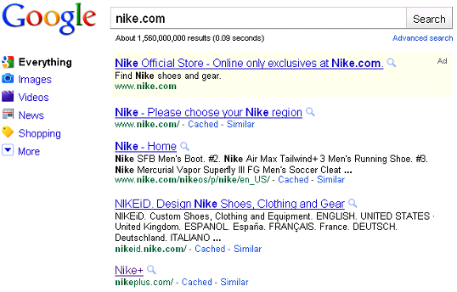
Navigation Queries are an Ideal Opportunity to Position Your Brand and Your Message
Notes:
Search is an Opportunity to Position your Brand Message

Slide 24
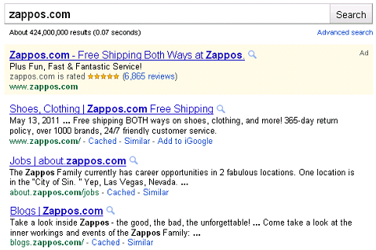
Use the Title Tag & Meta Description Tag
Title Tag
Meta
Description

Slide 25
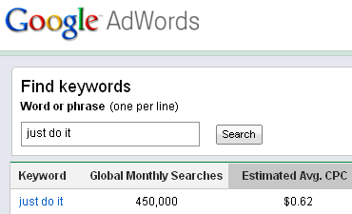
DO Support Other Marketing Initiatives with Search

Slide 26
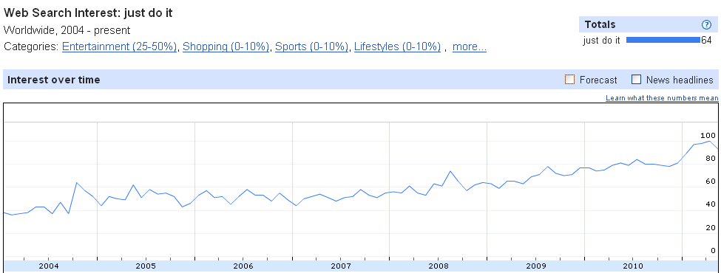
Search Trend for “Just Do It” Over Time

Slide 27
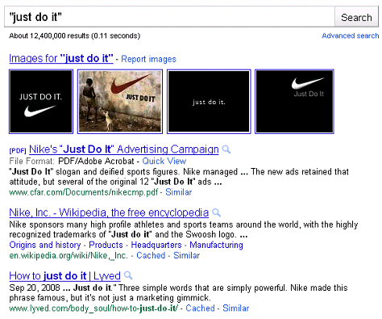
A Missed Opportunity
Google Search Results for “Just Do It”

Slide 28
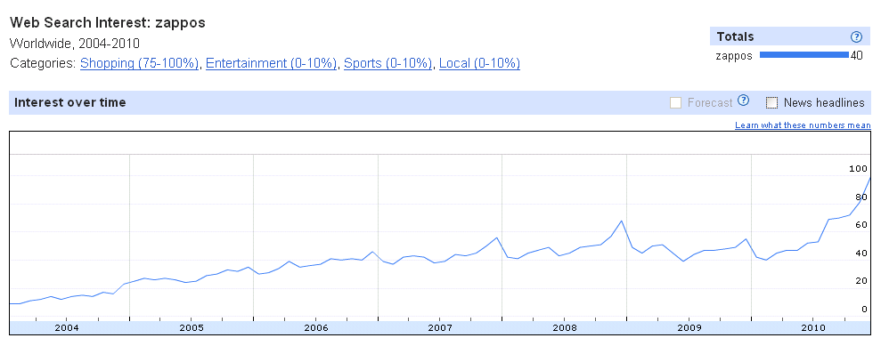
Do Use Search Data to Gauge Brand Awareness & Interest Over Time

Slide 29
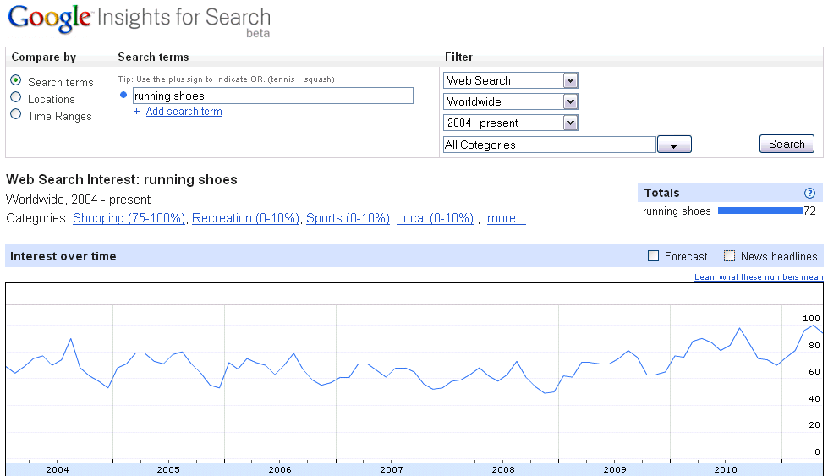
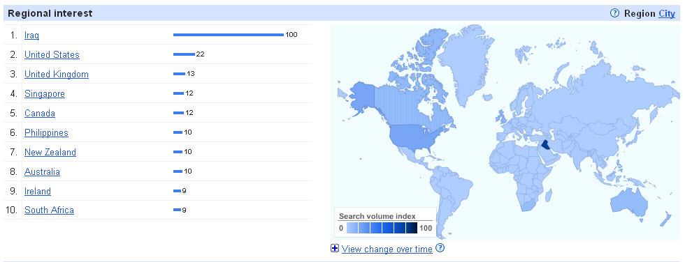
DO Use Search to Identify
Regional Interest in Products

Slide 30
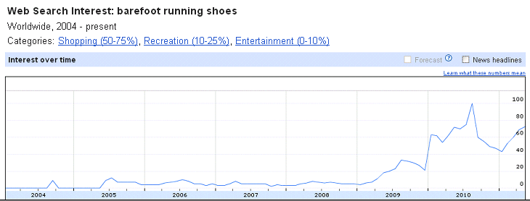
DO Use Search To Help Monitor the
Growth and Decline of Trends

Slide 31
DO Make Sure That Every Point of Entry Works to Satisfy the Searcher’s Query Intent
Buy
Call
Share
Download
Subscribe
Watch a video
Click an ad
Add content (comments, posts)
Send people to a location or a store

Slide 32
DO Include SEO Throughout Your Process
Planning
Keyword research to understand how the target market is looking for and thinking about this product
Design & Development
Intuitive IA
Launch & Monitor
Optimized templates & assets
Identify & resolve accessibility issues
Monitor crawl and indexing to identify overlooked or unforeseen issues
Identify opportunities where search can support the project
Create sitemap feeds
Maximize site speed
Collect and analyze data
Use data to identify search trends and develop content

Slide 33
DO Understand How Search Engines “See” Your Site
SITE:www.domainname.com
Show your indexed pages
CACHE:www.domainname.com/page.html
Click the “Text Only” link

Slide 34
DON’T Waste Your Time
Code validation
Keyword density
Meta keyword tag
Absolute volume of pages indexed
Using NOFOLLOW tags on links to “sculpt” or hoard or link equity

Slide 35
DON’T Ignore SEO!
(your competitor isn’t)

Slide 36
Tools in this Presentation
Google Keyword Research https://adwords.google.com/select/KeywordToolExternal
Google Insights http://www.google.com/insights/search
Google Trends http://www.google.com/trends
Google SEO Starter Guide http://www.google.com/webmasters/docs/search-engine-optimization-starter-guide.pdf
Canonical tag information http://www.mattcutts.com/blog/canonical-link-tag/
More Resources

Slide 37
This presentation will be available
for download tomorrow at:
www.alexbennert.com/CBS
Thank You!
Alex Bennert
@SEOsylph
ab@alexbennert.com
Notes:
37

